Slide 1
New York CitiBike Trips
Data Analytics and Visualization | Project Proposal
Team members:
Amin Fadaeinejad, Pouya Firoozmakan, Sajjad P. Savoji
Instructor: Jarek Gryz
Winter 2022

Slide 2
Introduction
The benefits to having such a system include
Encouraging public health through the exercise attained by cycling
Reducing New Yorkers’ dependence on automobiles
Reducing CO2 emission
Economical benefits both for the citizens and the government
There are currently about 12,000 shared bikes which users can rent from about 750 stations
Located mainly in Manhattan, Brooklyn, Queens, etc.
The system has been expanding each year
Increases in the number of bicycles available
Expansion of the geographic footprint of docking stations

Slide 3
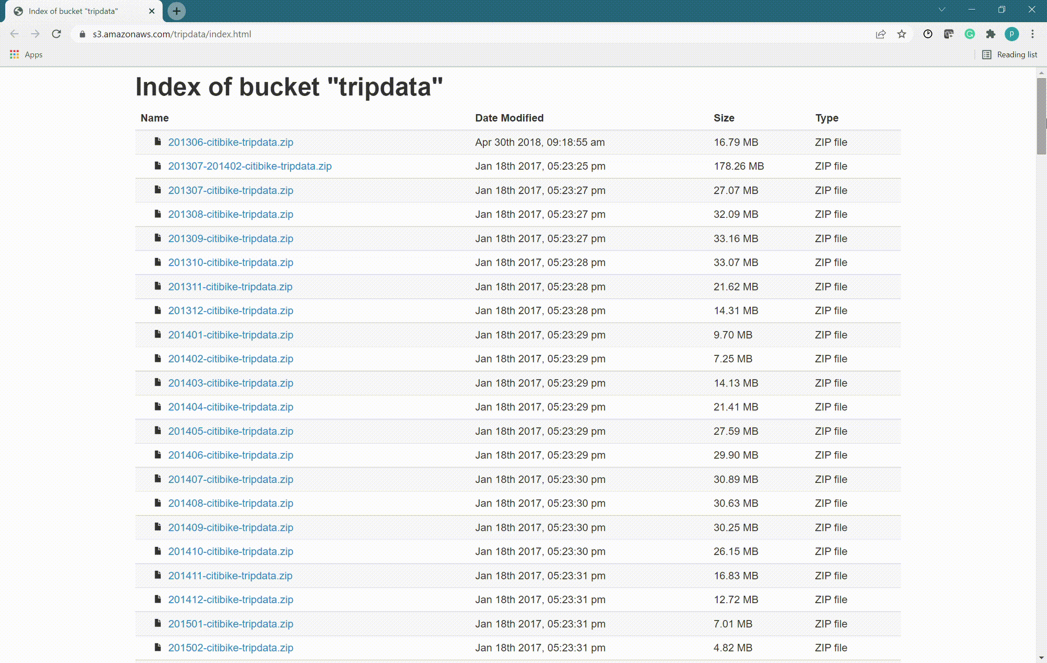
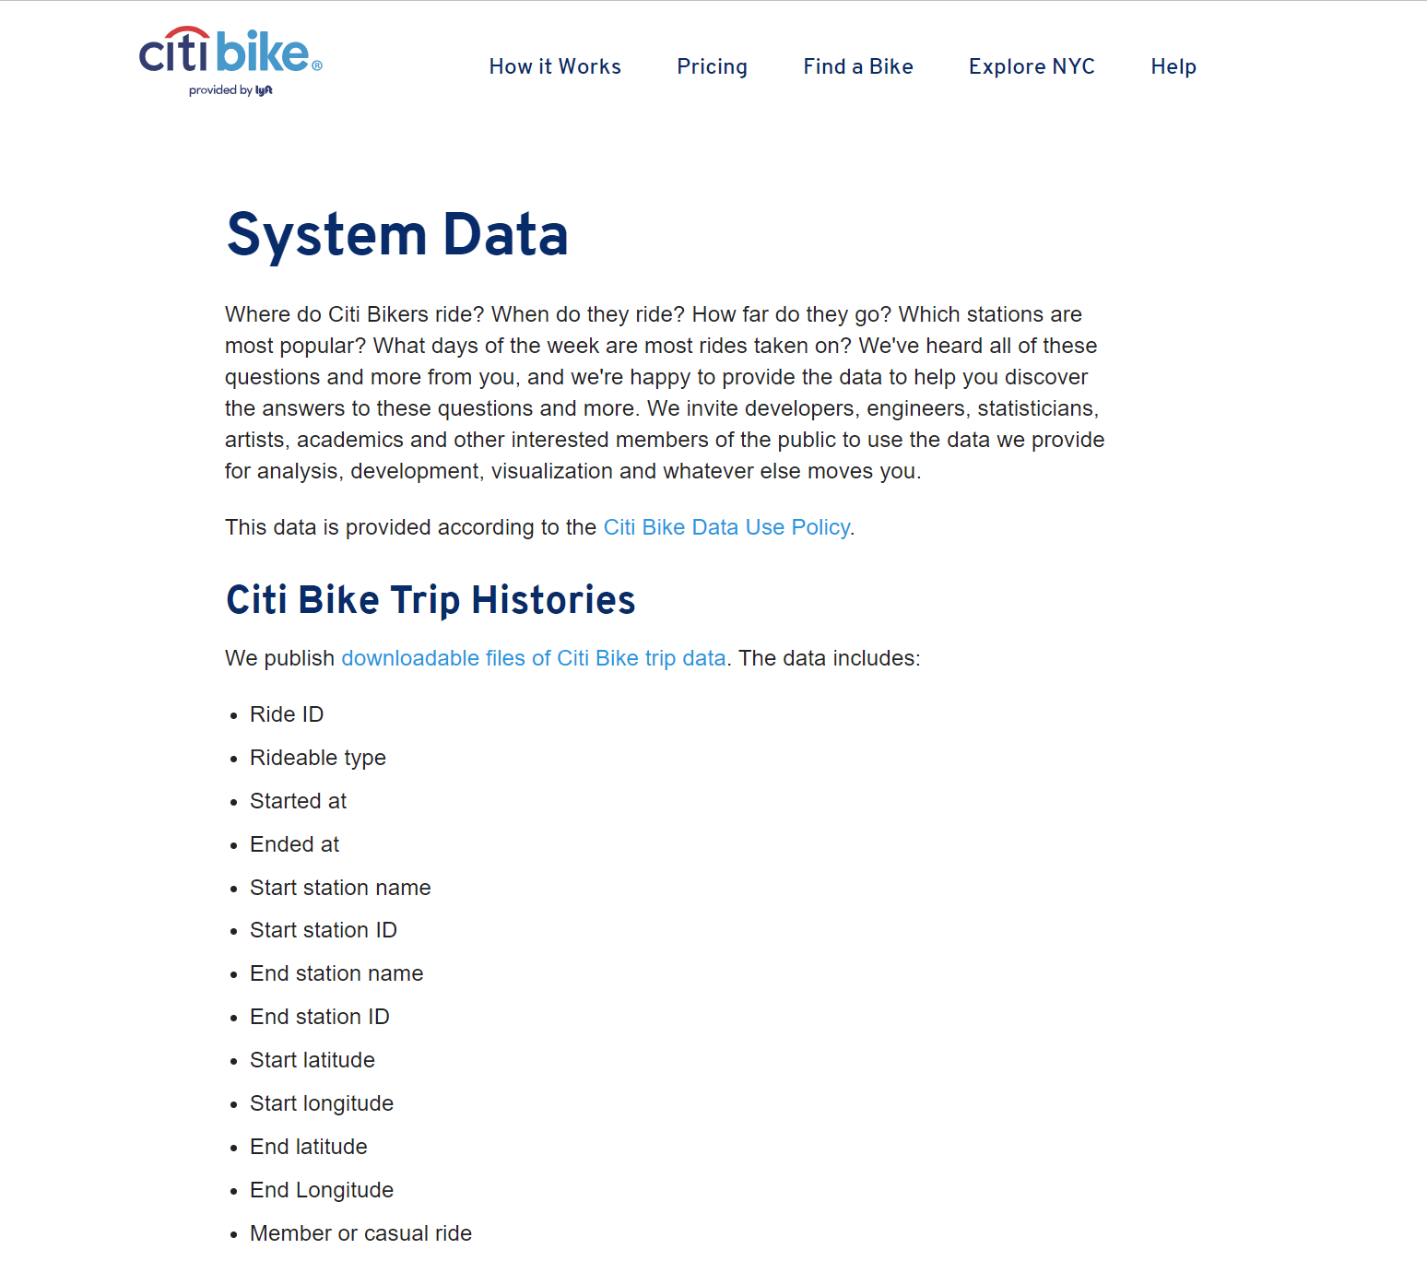
Dataset

Slide 4
Dataset
CitiBike makes a vast amount of data available regarding system usage as well as sales of memberships
For each month since the system’s inception, there is a file containing details of (almost) every trip
If a user checks out a bike from a dock but then returns it within one minute
Trips made by the administrators
Relocating bikes for maintenance
There are currently
102 month of data
July 2013 - Jan 2022
> 100 million trips
> 200 GB of data
Features of dataset
Ride ID
Bike ID
Starting location(Station ID)
Ending location(Station ID)
Starting and ending time
Membership status
Gender

Slide 5
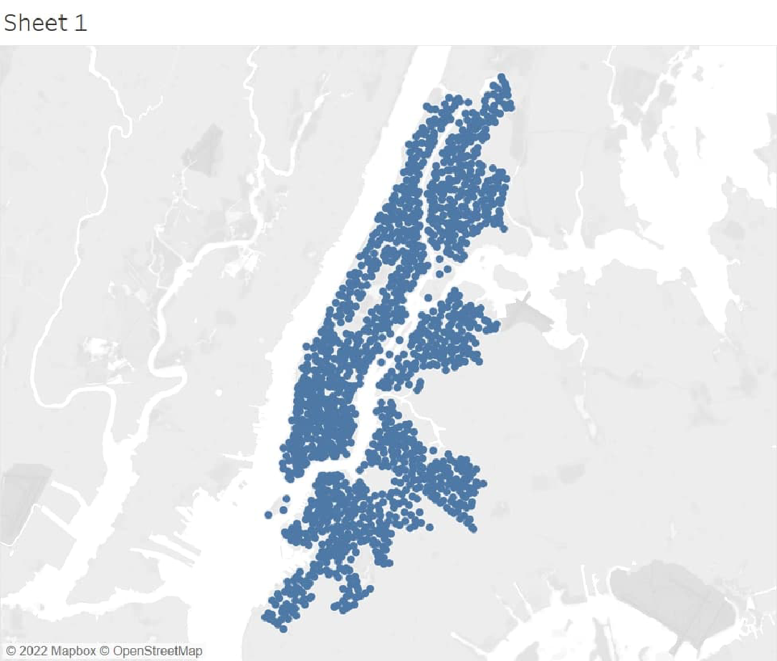
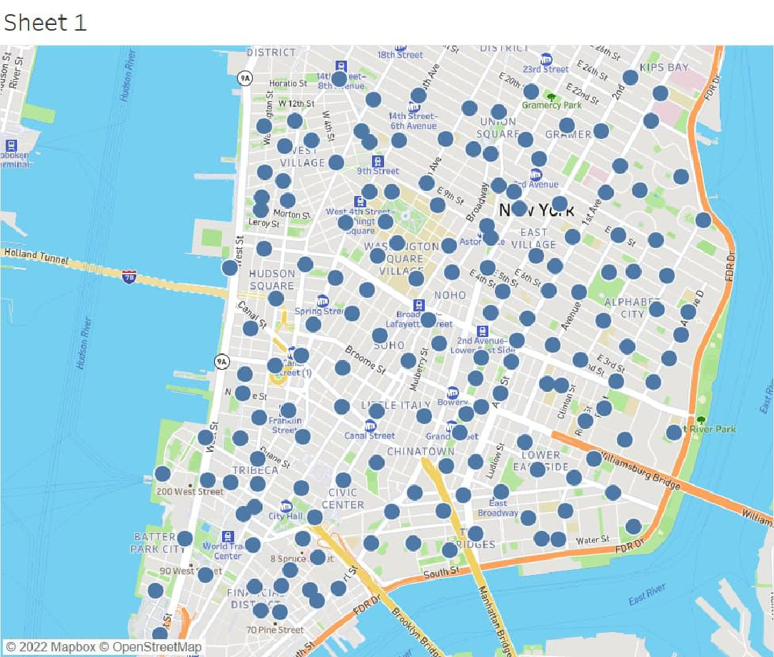
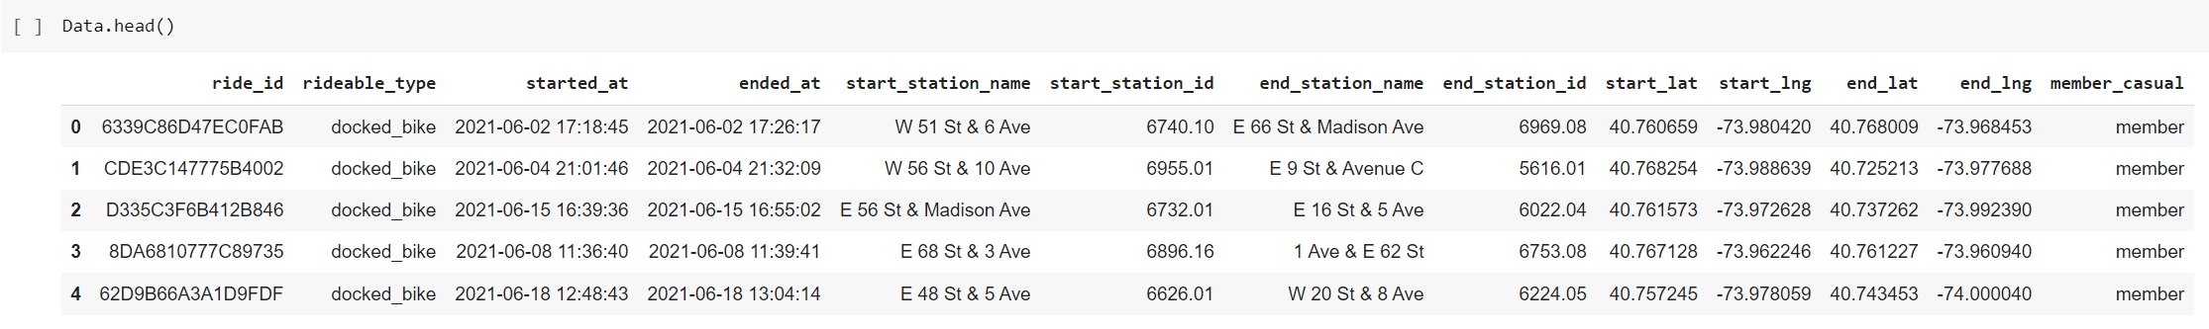
Dataset

Slide 6
Potential Analyses
Which stations are most commonly used?
Is there any spatial/geographical cues for usage trends?
Are there any usage trends in terms of average trip duration and distance?
During which time spans in a day these bikes are most commonly used?
Using the number of trips starting and those ending in stations,
can we come up with a non-uniform bike allocation scheme?
What are the potential locations for expansion of this network?
Has the pandemic affected the growth of bike share? And to what extent?
Is there a footprint of maintenance routines in the data set?
Does gender have an impact on one's usage pattern?

Slide 7
References
[1] An, Ran, Renee Zahnow, Dorina Pojani, and Jonathan Corcoran. 2019. “Weather and Cycling in New York: The Case of Citibike.” Journal of Transport Geography 77 (May): 97–112. https://doi.org/10.1016/j.jtrangeo.2019.04.016.
[2] Fuller, Daniel, Hui Luan, Richard Buote, and Amy H. Auchincloss. 2019. “Impact of a Public Transit Strike on Public Bicycle Share Use: An Interrupted Time Series Natural Experiment Study.” Journal of Transport & Health 13 (June): 137–42. https://doi.org/10.1016/j.jth.2019.03.018.
[3] Heaney, Alexandra K., Daniel Carrión, Katrin Burkart, Corey Lesk, and Darby Jack. 2019. “Climate Change and Physical Activity: Estimated Impacts of Ambient Temperatures on Bikeshare Usage in New York City.” Environmental Health Perspectives 127 (3): 37002. https://doi.org/10.1289/ehp4039.

Slide 8
Thank you!
Any Questions?

